Slide 1
Variety Dynamics support for System Dynamics
Dr Terence Love
CEO, Design Out Crime and CPTED Centre, Adjunct , University of Tehran, Iran
Dr Trudi Cooper
Social Science Faculty Edith, Cowan University

Slide 2
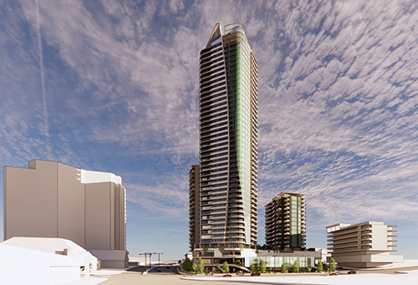
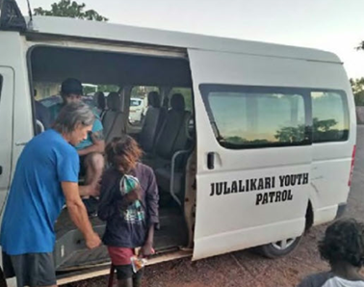
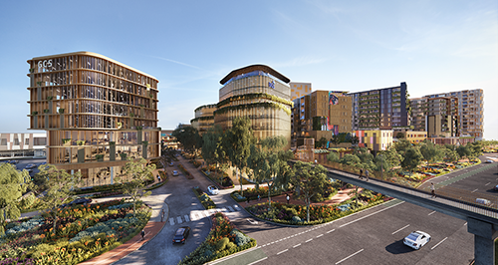
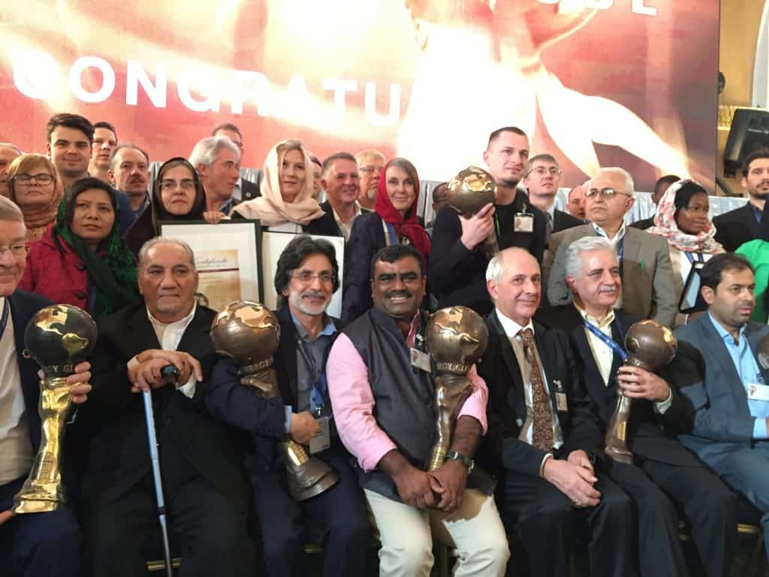
Selected projects
Undertaking systems projects for over 40 years…
Indigenous night patrols
Federal Attorney Generals Office
Cockburn Quarter $1.1 billion
Iconic retail residential~ $1 billion
Multi-agency community development and crime prevention for public transport
Farmer support in India
Rainwater Harvesting

Slide 3
What is Variety Dynamics?
New theory foundation in systems theory, mathematics, ecology, crime prevention, ecology, warfare and security studies, quantum physics and other disciplines…

Slide 4
Variety Dynamics Origins
Developed in 1990s by Terence Love and Trudi Cooper to address some systems analysis limitations - ongoing
Systems and sub-systems changing in boundaries, existence, purpose and ownership
Incoherent boundaries
2 feedback loop limitation on mental prediction of outcomes
Coercive systems
Wicked (and super-wicked) problems
Hyper-complex and chaotic systems
Corrupt systems
Control of complex systems by less powerful actors
Implications for systems theory of robotisation, automation, AI and ML
Managing incoherent actions – e.g. surprise attacks

Slide 5
What is Variety?
Variety is the number of possible states of something
Variety = 5 of colour of the cakes - CARDINALITY

Slide 6
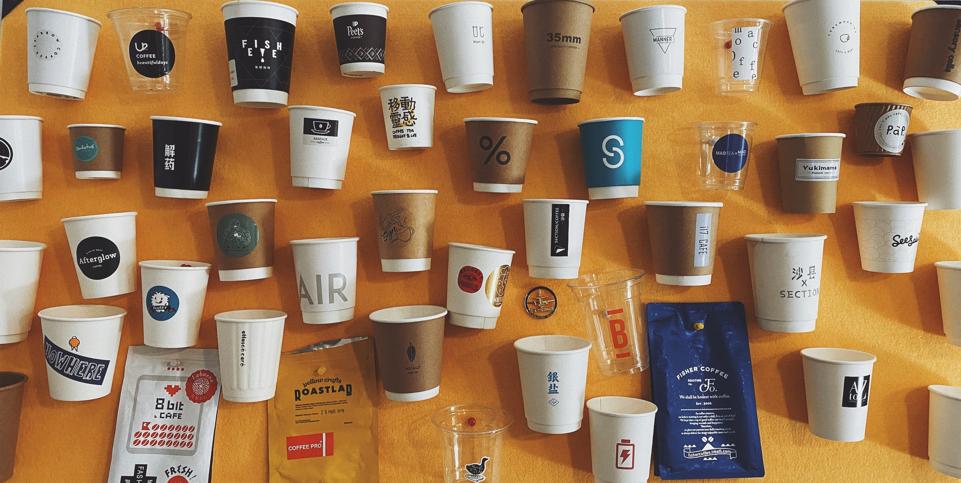
Variety space multidimensional
The additional variety of handles, size, materials, style, coating etc can be represented in multiple dimensions in variety space
Multidimensional
Variety space for cups

Slide 7
Variety Dynamics
Variety distributions can be dynamic – changing over time
Variety distribution – crime triangle
Variety – Motivated criminals
Changes over time
Variety - Guardians
Changes over time
Variety – Crime targets
Changes over time

Slide 8
System Dynamics
Primary role of SD is to help managers of complex systems (2 or more feedback loops)
Primary output of SD is the prediction of behaviours
Uses causal relations between factors to create a time-stepped first order difference model
Model predicts increases and decreases in specific variables given certain management decisions
Managers can use the SD model predictions to help identify good decisions
Missing from SD is power dynamics and ability to guide managers in best choice of decisions (especially to manipulate flow of power)

Slide 9
Scope of Variety Dynamics
Managing behaviours, power relations and system structures in complex socio-technical and environmental systems:
Systems with changing porous system boundaries
Multiple constituencies – changing over time
Multiple overlapping dynamically changing sub-systems
Multiple overlapping processes across subsystems
Mixed and changing ownership of sub-systems
Subsystem and system existence, roles, power, ownership and boundaries changing over time
Varying purposes and roles of system and sub-systems changing over time
Complex and dynamic distribution of formal and informal power and control

Slide 10
Law of Requisite Variety
Law of Requisite Variety :
‘For a system to be stable, the number of states that its control mechanism is capable of attaining (its variety) must be greater than or equal to the number of states (the variety) in the system being controlled.’
(W. Ross Ashby (1956): An Introduction to Cybernetics, Chapman & Hall, London.)
LoRV is one of the few laws that applies across most disciplines

Slide 11
Control variety and system variety (Ashby’s Law)
Variety system distribution
Variety – control system
Variety – system being controlled
Variety of control system must be greater than the system being controlled
(Ashby’s Law of Requisite Variety)

Slide 12
Real situations with dynamic variety distributions
Variety 2
SYSTEM BOUNDARY (continuously changing)
Variety 3
Variety 1
Variety 4
Variety 7
Variety 5
Variety 6
SUB-SYSTEMS
Distributions of variety and control and ownership are changing continuously in highly irregular interrelated ways

Slide 13
Variety Dynamics Axiom example
So far have identified 29 Variety Dynamics axioms:
Axiom 1:
For complex, layered and hierarchical systems involving multiple constituencies in which the distribution of variety generation and control is uneven across the system
THEN
The differing distributions of generated and controlling variety result in a structural basis for differing amounts of power and hegemonic control over the structure, evolution and distribution of benefits and costs of the system by particular constituencies.

Slide 14
Practical example A xiom 1: Activists vs motor industry
Environmental activists were able to overcome motor industry resistance to emissions control:
Activists asked motor industry to implement strict emission standard - motor industry refused
Activists persuade each state to create different emission standards (i.e. increased variety beyond motor industry’s ability to control)
Motor industry agrees to single strict emission standard
Management of variety resulted in transfer of power to activists from motor industry.

Slide 15
Causal loop diagram as used by US Army COIN strategists in Afghanistan

Slide 16
Variety dynamics analysis for managing flow of power
Variety available to military less than variety available to insurgents, e.g. Pashtunwali

Slide 17
Variety Dynamics Axioms
We have currently identified a further 29 Variety Dynamics axioms
Each of these Variety Dynamics axioms provides managers with guidance
They indicate the best management decisions when using on an SD model or Causal Loop diagram
To achieve intended outcomes
To change the flow of power in preferred ways
More importantly, they extend System Dynamics into the realm of hyper-complex systems that cannot be currently addressed by SD approaches

Slide 18
Connection between Variety Dynamics and System Dynamics
The mechanism of System Dynamics modelling is as time stepped first order difference equations
Any type of variety assessment (e.g. colours, fruit etc) depends on human-defined criteria
Variety criteria in SD can be specified similarly.
That enables SD software to also map variety across causal relations
Similar for sub-system definition, ownership and dynamics

Slide 19
Corruption model for analysis using Variety Dynamics

Slide 20
For more information on Variety Dynamics Dr Terence Love 0434 975 848 admin@loveservices.org

